Slide 1
UNIT-IV
Packages, Exception handling

Slide 2
Unit – IV | Contact Hours = 8 Hours
Packages: Package fundamentals, packages and member access, importing packages, static import. Exception handling: the exception hierarchy, exception handling fundamentals, exception types, uncaught exceptions, using try and catch, multiple catch clauses, catching subclass exceptions, nested try, throw, throws, finally, Java’s built-in exceptions, creating your own exception subclasses.

Slide 3
Exception handling:
The exception hierarchy:
Exception handling fundamentals
Exception types
uncaught exceptions
using try and catch
multiple catch clauses catching subclass exceptions, nested try, throw, throws,
finally, Java’s built-in exceptions,
creating your own exception subclasses.

Slide 4
The Exception Hierarchy
All exception classes are derived from a class called Throwable.
When an exception occurs in a program an object of some type of exception class is generated.
There are 2 direct subclasses of Throwable: exception and error.
Exceptions of type Error are related to errors that are beyond the control, which occur in JVM itself.
Errors that result from program activity are represented by subclasses of Exception

Slide 5
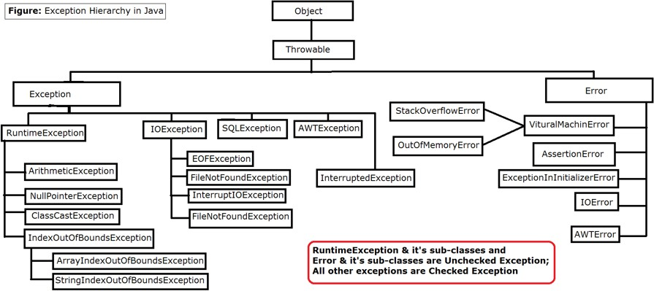

Slide 6
At the top of the hierarchy is the Throwable class, which is the superclass of all exceptions and errors. The Error class is a subclass of Throwable and represents serious errors that are usually not recoverable, such as StackOverflowError and OutOfMemoryError.
The Exception class is another subclass of Throwable and is the superclass of all checked exceptions. The RuntimeException class is a subclass of Exception and is the superclass of all unchecked exceptions. The remaining subclasses of Exception represent specific checked exceptions, such as IOException and SQLException.
Exceptions can be categorized into two types: checked exceptions and unchecked exceptions.
Checked Exceptions: Checked exceptions are the exceptions that are checked at compile-time.
If a method throws a checked exception, then the method must either handle the exception using a try-catch block or declare the exception using the throws keyword. Examples of checked exceptions include IOException, ClassNotFoundException, SQLException, etc.
Unchecked Exceptions:these exceptions occur at runtime and are not required to be declared in a method's throws clause. Examples of unchecked exceptions include NullPointerException, ArrayIndexOutOfBoundsException, ArithmeticException, etc.

Slide 7
Exception-Handling Fundamentals
Java exception handling is managed via five keywords: try, catch, throw, throws, and finally.
Program statements that you want to monitor for exceptions are contained within a try block. If an exception occurs within the try block, it is thrown.
Code can catch this exception (using catch) and handle it in some rational manner
System-generated exceptions are automatically thrown by the Java run-time system.
To manually throw an exception, use the keyword throw.
Any exception that is thrown out of a method must be specified as such by a throws clause

Slide 8

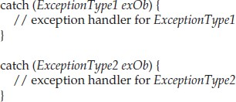
1. Using try and catch
This is the general form of an exception-handling block:
ExceptionType is the type of exception that has occurred
When an exception is thrown, it is caught by its corresponding catch clause
There can be more than one catch clause associated with a try block
The type of the exception determines which catch is executed
If the exception type specified by a catch matches that of the exception, then that catch clause is executed. All other catch clauses are bypassed
If no exception is thrown, then a try block ends normally
If no exception is thrown by a try block, no catch clause will be executed and program control will resume after the catch.

Slide 9
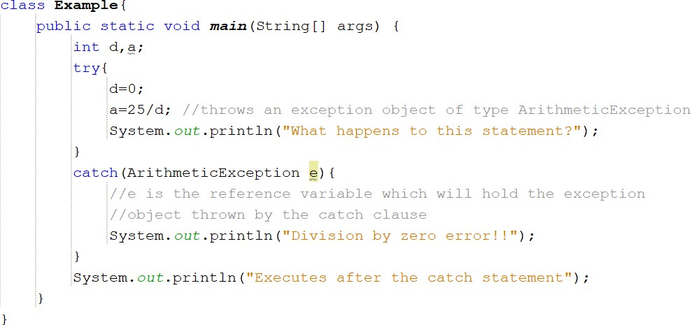
OUTPUT:

Slide 10
Key points on Exception Handling
The code which may generate errors need to be contained within try block.
When an exception occurs, the exception is thrown out of the try block making the try block to terminate. Then that exception will be caught by the catch block.
Hence, the call to println( ) inside the try block in the above code is never executed. Once an exception is thrown, program control transfers out of the try block into the catch block.
catch is not “called,” so execution never “returns” to the try block from a catch. Thus, the line “What happens to this statement .” is not displayed.
Once the catch statement has executed, program control continues with the next line in the program following the entire try/catch mechanism.

Slide 11
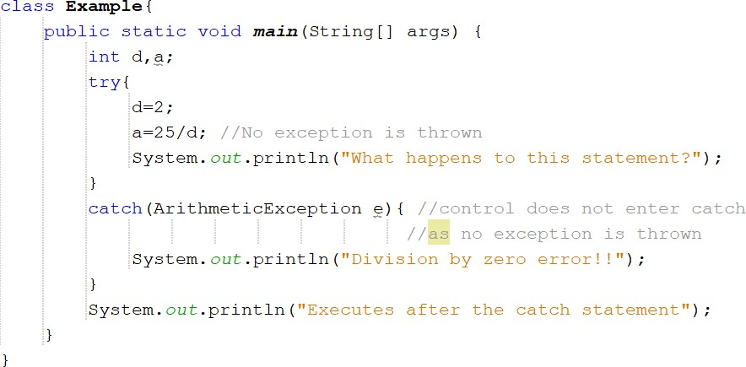
Example 2:
OUTPUT:
In the above program, no exception is thrown, hence catch clause is not executed

Slide 12
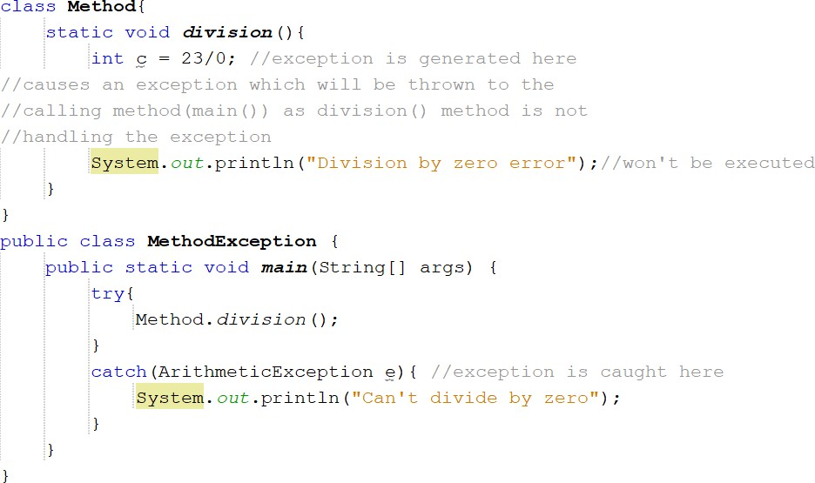
  Ex 3: Exception generated by a method called from within try block
OUTPUT:

Slide 13
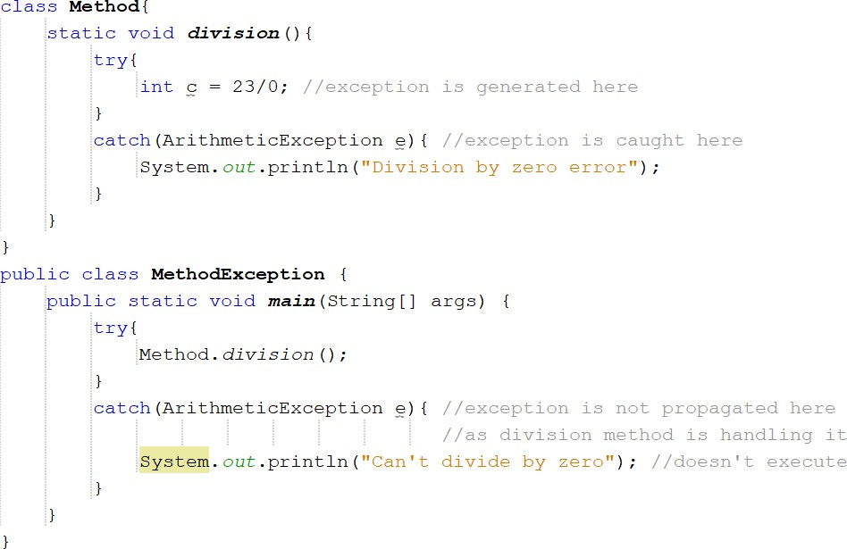
division() is called from within try block, the exception that it generates is caught by the catch in main()
if division() had caught the exception itself, it never would have been passed back to main().
For Example,
OUTPUT:

Slide 14
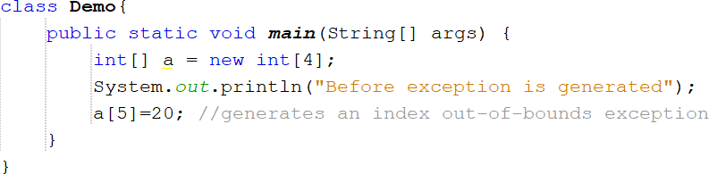
The Consequences of an Uncaught Exception
If the program does not catch an exception, then it will be caught by the JVM
But, JVM default exception handler terminates execution and displays an error message followed by list of method calls that cause the exception (referred as stack trace)à “abnormal termination”
For example,
OutPut

Slide 15
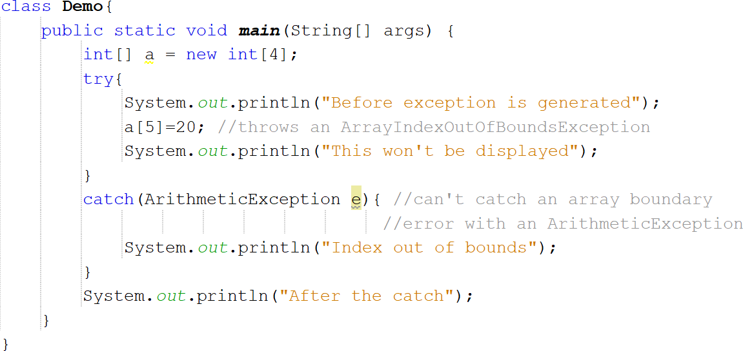
As you can see in the output, program terminates as soon as exception occurs
The type of the exception must match the type specified in a catch. If it does not, the exception would not be caught.
For example,
OUTPUT

Slide 16
The above program tries to catch an array boundary error with a catch for ArithmeticException, whereas ArrayOutOfBoundsException is generated when the array boundary is overrun.

Slide 17
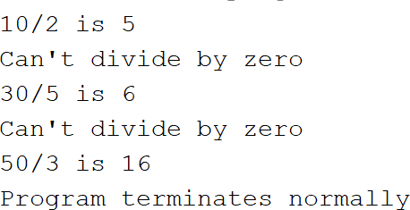
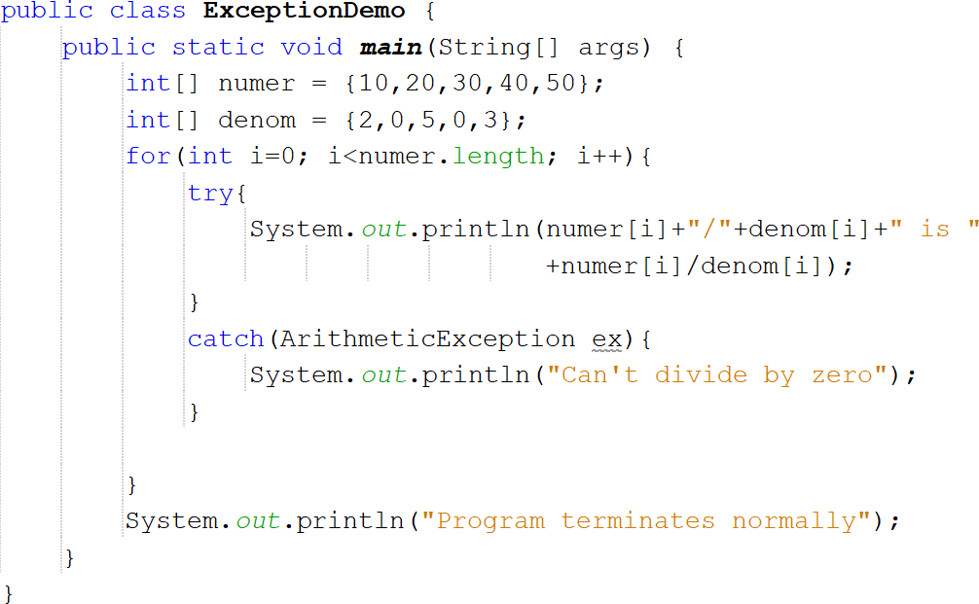
Exceptions Enable You to Handle Errors Gracefully
One of the key benefits of exception handling is that it enables the program to respond to an error in a graceful way
An exception handler can prevent abrupt program termination
For example,
OUTPUT
In the above program, if a division by zero occurs, an ArithmeticException is generated. This exception is handled by reporting the error and then continue with execution
Thus, attempting to divide by zero does not cause an abrupt termination of the program. Instead, it is handled and program execution is allowed to continue

Slide 18
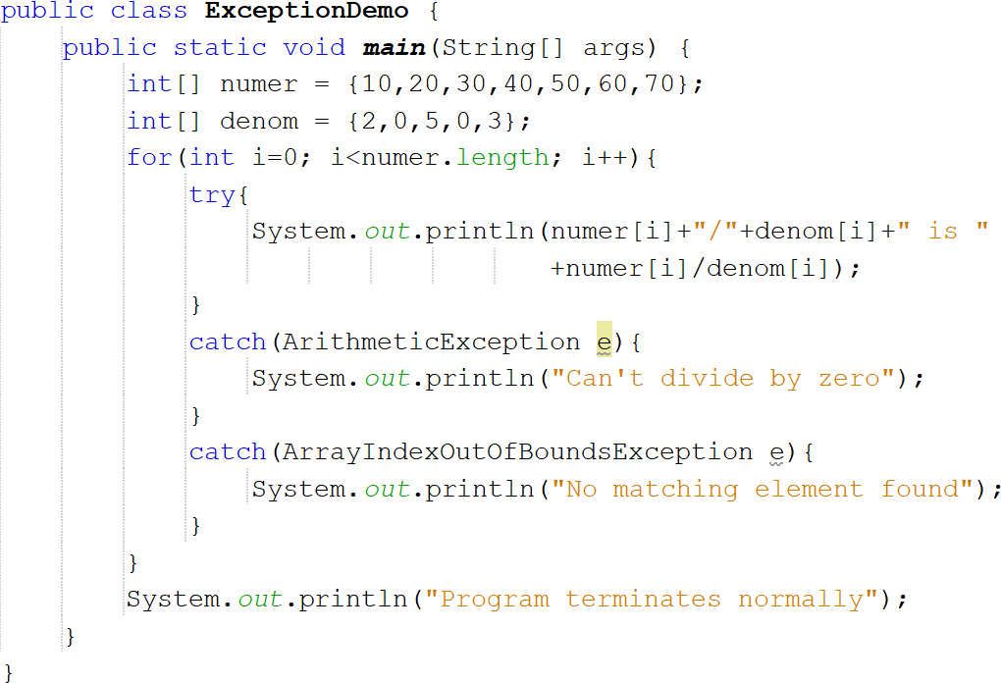
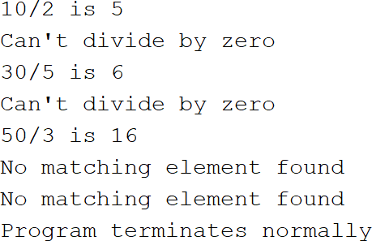
Using Multiple catch Clauses
In some cases, more than one exception could be raised by a single piece of code.
To handle this type of situation, you can specify two or more catch clauses, each catching a different type of exception.
When an exception is thrown, each catch statement is inspected in order, and the first one whose type matches that of the exception is executed.
After one catch statement executes, the others are bypassed, and execution continues after the try/catch block.
OutPut
Each catch responds only to its own type of exception
catch clauses are checked in the order in which they occur in a program

Slide 19
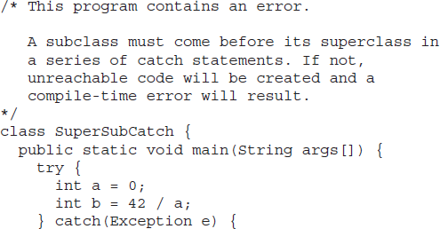
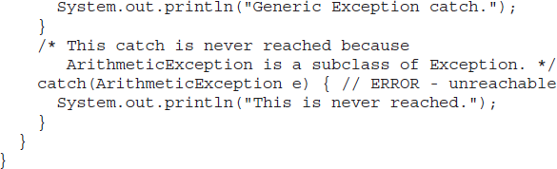
Catching Subclass Exceptions
When you use multiple catch statements, it is important to remember that exception subclasses must come before any of their superclasses.
This is because a catch statement that uses a superclass will catch exceptions of that type plus any of its subclasses. Thus, a subclass would never be reached if it comes after its superclass.

Slide 20
catch statement will handle all Exception-based errors, including
ArithmeticException. This means that the second catch statement will never execute
To solve this problem, Superclass Exception class must be included as the last catch clause
Nested try blocks
A try statement can be inside the block of another try.
An exception generated within the inner try block that is not caught by a catch associated with that try is propagated to the outer try block

Slide 21
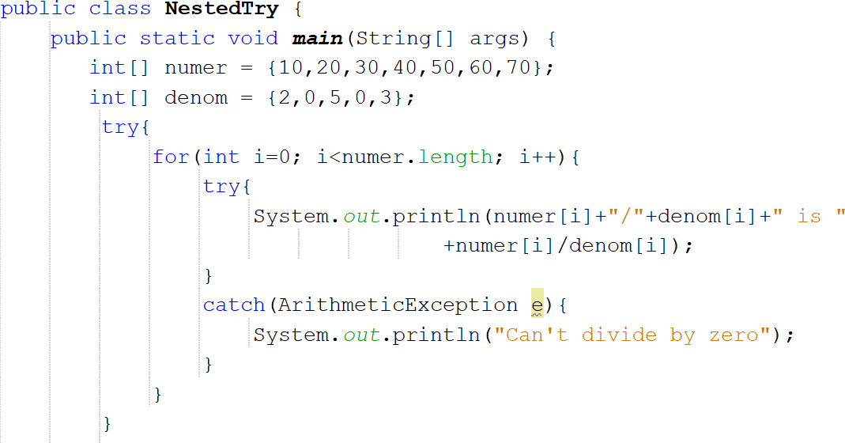
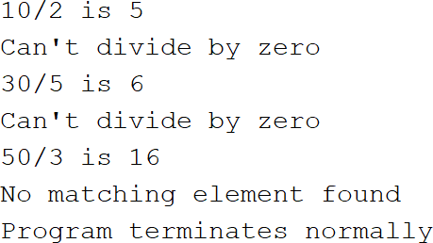
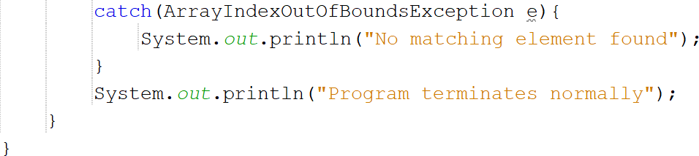
OUTPUT
In this example, an exception that can be handled by the inner try, a divide by zero allows the program to continue.
An array error boundary error is caught by the outer try which terminates the program

Slide 22
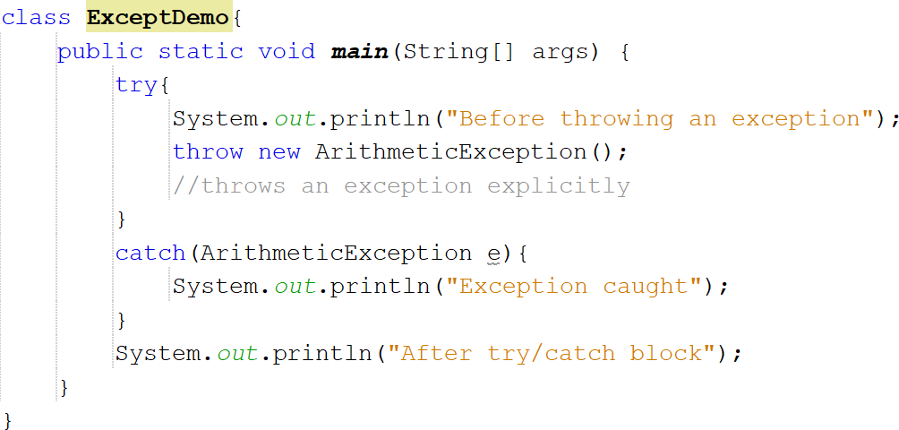
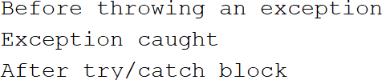
Throwing an Exception
Preceding examples have only been catching exceptions that are thrown by the Java run-time system.
However, it is possible for the program to throw an exception explicitly, using the
throw statement.
The general form of throw is as follows:
throw exceptOb;
exceptOb must be an object of an exception class derived from Throwable
throw throws an object
OUTPUT

Slide 23
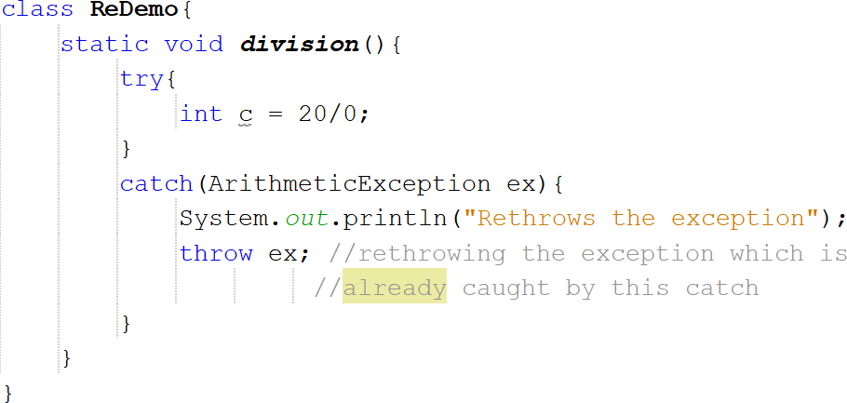
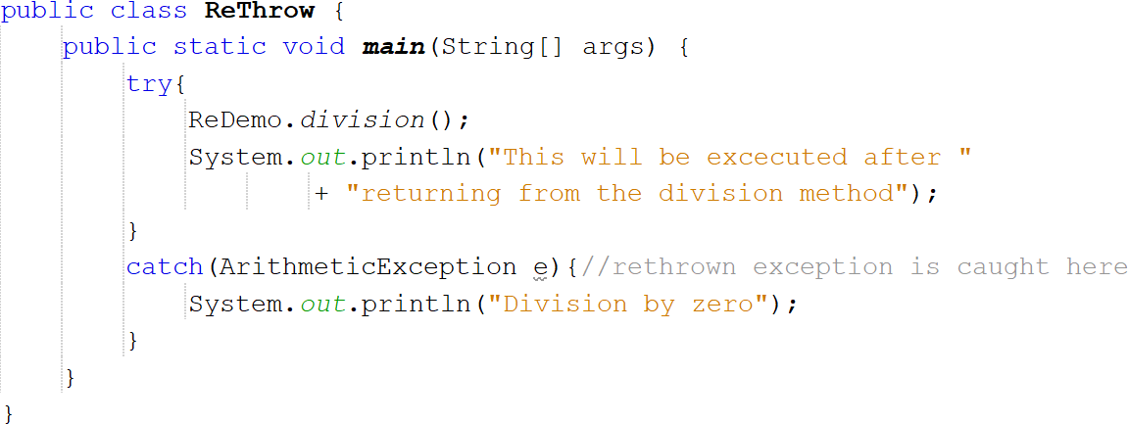
Rethrowing an Exception
An exception caught by one catch can be rethrown so that it can be caught by an outer catch
For example,
First, main( ) sets up an exception context and then calls division( ).
The division() method then sets up another exception handling context and immediately throws a new instance of ArithmeticException, which is caught on the next line. The exception is then rethrown.

Slide 24
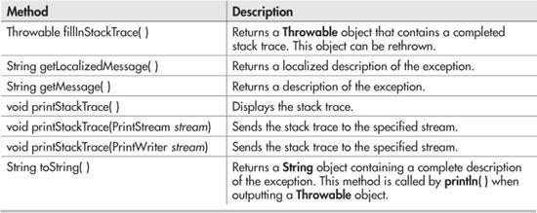
Throwable

Slide 25
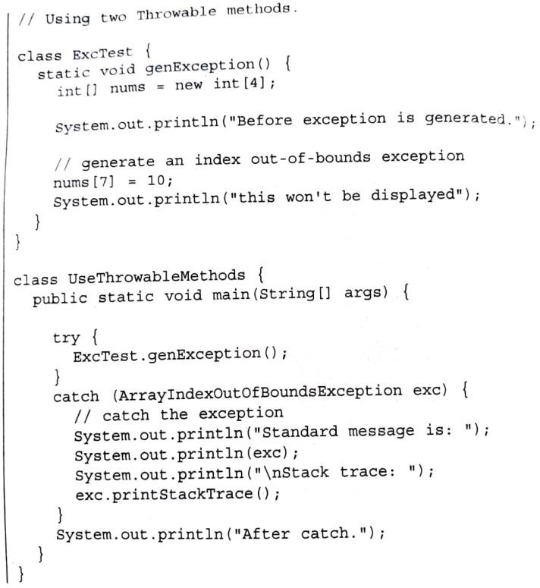
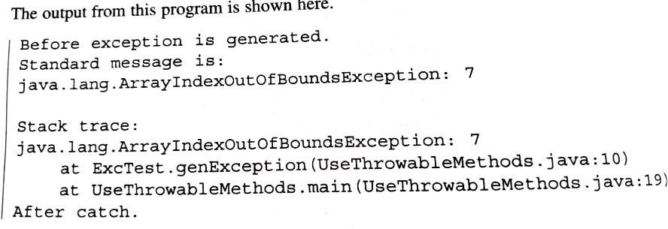

Slide 26
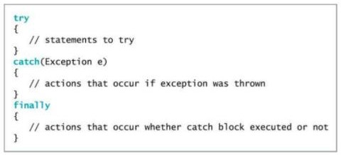
Using finally
In Java, the finally block is used in combination with a try and/or catch block to provide a final piece of code that is always executed, regardless of whether an exception is thrown or not.
The finally block is optional, but when it is used, it will be executed after any catch block(s), and will always be executed, even if an exception is thrown or the program exits abnormally.
The general form of try/catch that includes finally is
The finally block is typically used to close resources that were opened in the try block, such as files, network connections, and database connections.
This ensures that the resources are properly released, regardless of whether an exception was thrown or not.

Slide 27
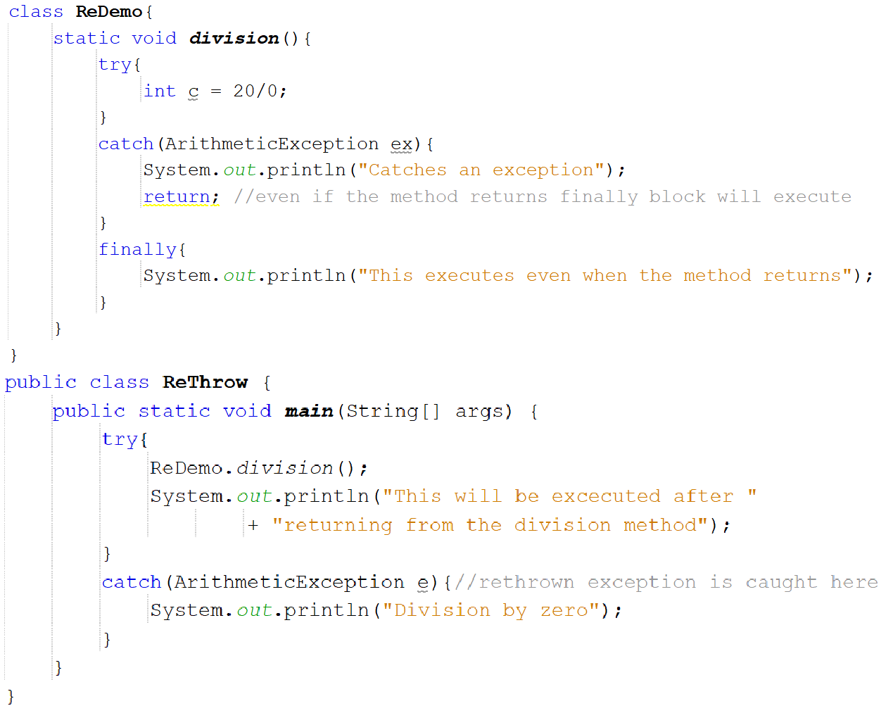
OUTPUT
In the above example, finally block is executed even after the method returns

Slide 28

Using throws
In Java, the throws keyword is used in a method signature to declare that the method may throw one or more exceptions.
When a method is declared with a throws clause, it is indicating that it is possible for the method to throw an exception during its execution, and that it is up to the calling code to handle that exception.
A throws clause lists the types of exceptions that a method might throw.
The general form a method that includes a throws clause:
public void myMethod() throws ExceptionType1, ExceptionType2, ... {
// Method code that may throw one of the declared exceptions
}
Here, exception-list is a comma-separated list of the exceptions that a method can throw

Slide 29
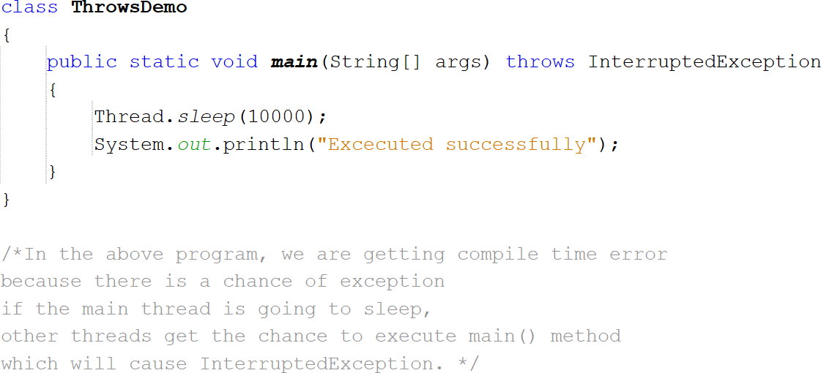
Important Points about throws:
In the above example, main( ) throws InterruptedException but does not handle it
main( ) must define a try/catch statement that catches this exception.

Slide 30
For example, consider the following method that opens a file and reads its contents:
public String readFile(String fileName) throws FileNotFoundException, IOException {
FileInputStream fis = new FileInputStream(fileName);
StringBuilder sb = new StringBuilder();
int ch;
while((ch = fis.read()) != -1) {
sb.append((char) ch);
}
fis.close();
return sb.toString();
}
public void myMethod() {
try {
String contents = readFile("file.txt");
System.out.println(contents);
} catch(FileNotFoundException e) {
// Handle the FileNotFoundException
} catch(IOException e) {
// Handle the IOException
}
}

Slide 31
throws keyword is required only for checked exception and usage of throws keyword for unchecked exception is meaningless.
throws keyword is required only to convince compiler and usage of throws keyword does not prevent abnormal termination of program.

Slide 32
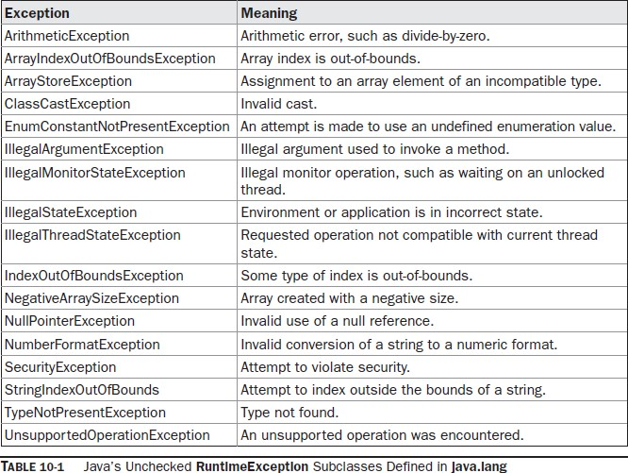
Java’s Built-in Exceptions
java.lang is implicitly imported into all Java programs

Slide 33
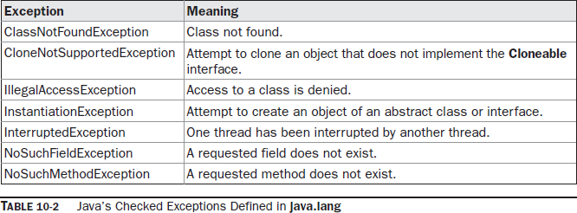

Slide 34
8. Write a program to demonstrate the implementation of customized exception handling.
Assume that you have received a request from the transport authority for automating the task of issuing the permanent license for two wheelers. The mandatory condition to issue the license are: 1) the applicant must over 18 years of age and 2) holder of a valid learner’s license and 3) no accident cases in the last one year.
Write a Java program that reads user details as required (use the Scanner class). Create user defined exceptions to check for the three conditions imposed by the transport authority. Based on the inputs entered by the user, decide and display whether or not a license has to be issued or an error message as defined by the user exception.

Slide 35
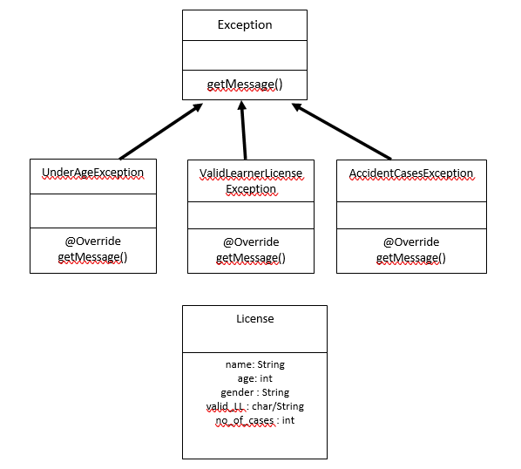

Slide 36
import java.util.Scanner;
class UnderAgeException extends Exception{
UnderAgeException(String s){
super(s);
}
@Override
public String toString(){
return "Sorry. You are too young for the license";
}
}

Slide 37
class ValidLLR extends Exception{
ValidLLR(String s){
super(s);
}
@Override
public String toString(){
return "Sorry. You do not hold a valid LLR";
}
}

Slide 38
class NumAccidents extends Exception{
NumAccidents(String s){
super(s);
}
@Override
public String toString(){
return "Sorry. There are accidents in last one year";
}
}

Slide 39
class License{
String name;
int age, no_of_cases;
char gender;
char validLLR;
void readData(){
Scanner in=new Scanner(System.in);
System.out.println("Enter the name: ");
name = in.nextLine();
System.out.println("Enter the age: ");
age = in.nextInt();
System.out.println("Enter the gender: ");
gender = in.next().charAt(0);
System.out.println("Do you have Valid LLR (Y/N)? ");
validLLR = in.next().charAt(0);
System.out.println("How many number of cases in past one year? ");
no_of_cases = in.nextInt();
}
}

Slide 40
public class TW8 {
public static void main(String[] args) {
License applicant =new License();
applicant.readData();
validateApplicant(applicant);
}
static void validateApplicant(License a){
try{
if(a.age<18)
throw new UnderAgeException("Underageexception:");
if(a.validLLR!='Y')
throw new ValidLLR("ValidLLRexception:");
if(a.no_of_cases>0)
throw new NumAccidents("Numberofaccidentsexception:");
System.out.println("Congrats!! Your license is being posted");
}

Slide 41
catch(UnderAgeException e){
System.out.println(e.getMessage()+e);
}
catch(ValidLLR e){
System.out.println(e.getMessage()+e);
}
catch(NumAccidents e){
System.out.println(e.getMessage()+e);
}
catch(Exception e){
System.out.println(e.getMessage()+e);
}
}
}

Slide 42
PACKAGES
It is helpful to group related pieces of a program together. This is accomplished by using a package.
A package serves two purposes:
First, it provides a mechanism by which related pieces of a program can be organized as a unit. Classes defined within a package must be accessed through their package name.
Second, a package participates in Java’s access control mechanism.
Classes defined within a package can be made private to that package and not accessible by outside code

Slide 43
Defining a package
All classes in Java belong to some package.
When no package has been explicitly specified, the default or global package is used.
The default package has no name.
To create a package, use the package statement which is located at the top of a Java source file.
A class declared within that file will belong to the specified package.
The general form of the package statement is.
package pkg;
• For example: package mypack;
Hierarchy of packages can be created by separating each package name from the one above it by use of a period.
The general form of a multi leveled package statement is
package pack1.pack2.pack3…….packN;

Slide 44
Finding Packages and CLASSPATH
The Java run-time system know where to look for packages that is created by doing following things:
1. First, by default, the run-time system uses the current working directory as its starting point. If the package is in a subdirectory of the current directory, it will be found
2.Second, a directory path or paths can be specified by setting the CLASSPATH environmental variable.
3. Third, the -classpath option can be used java and javac to specify the path to the classes

Slide 45
Advantages of using Packages in Java:
Modularity: Packages provide a modular structure to the program. It helps in grouping related classes and interfaces, which makes the program easier to understand and maintain.
Access Control: Packages provide access control to the classes and interfaces. The classes and interfaces within a package can be accessed only by the classes and interfaces within the same package.
Namespace Management: Packages provide a namespace management system that prevents naming conflicts between the classes and interfaces.
Reusability: Packages provide a way to reuse the code across different projects. The code can be packaged as a library and used across different programs.

